Slide 1

Visible Light Communication Protocol Security
Mobile and Wireless Networks
Andriamahefa RAMIARAMANANA
Zlatan KOVACEVIC
Semilogo OLUSOLA OGUNGBURE
Notes:
Indoor wireless communications are evolving as a result of light-emitting diodes (LEDs). LED-based visible light communications (VLC) is a developing research field with enormous economic potential. The primary problems with 5G and Internet of Things (IoT) communication systems can be resolved by the developing and promising idea known as visible light communications (VLC). The focus of this article is on cutting-edge VLC systems, which include transmitters, receivers, and channel models, as well as existing modulation and networking algorithms for the physical layer and proposed methods in the use of VLC for loT. Indoor localization algorithms are put forth, with an emphasis on identifying the problems encountered while using VLC for loT and providing remedies when necessary. Then, we determine future directions for study in the application of VLC for loT

Slide 2
Visible Light Communication Protocol Security
Table of Contents
Introduction
VLC System, 5G for IoT
Is VLC Really Necessary for IoT Networks Deployment?
Existing and Proposed Multiple Access Technique in VLC-IoT
Handover
Existing Handover Mechanisms in VLC-IoT
Proposed Handover Approach
VLC Architecture
Physical Layer Security
PLS Embedded Encryption
Chaos-based Physical layer security model
Friendly Jamming/Zero-Forcing
DRL-Based IRS-Assisted
Data Link Layer Security
MAC Layer Location Based RSA
Elliptic Curve Cryptography
Chaffing and Winnowing
Challenges, Solutions & Opportunities in VLC-IoT
VLC Attacks \& Vulnerabilities
VLC Attacks \& Vulnerabilities
Research on Improved Handover Techniques
Conclusion
Notes:
Light Communications (VLC) is a communication technology that uses light as the medium to transmit data. This technology is based on the principles of Electromagnetic Radiation and Optics. Light, being a form of electromagnetic radiation can be modulated to transmit data in the form of digital signals.This is a new paradigm in wireless communication known as the internet of light-emitting diodes (LED) which integrates IoT with VLC using LED. Today, there is genuine concern for research efforts to investigate new wireless communication alternatives capable of delivering massive connectivity, diverse data rates, low latency, and efficiency as well as high security. VLC systems operate by modulating light signals and transmitting data through LED sources, which are then decoded by photodetectors.

Slide 3
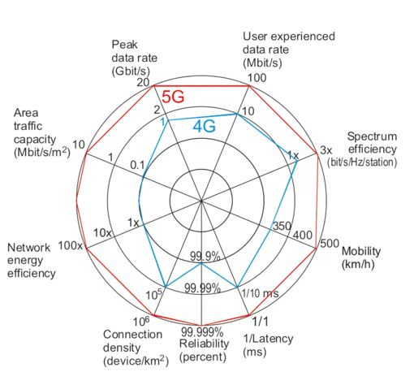
Visible Light Communication Protocol Security
Introduction
Visible light communications System (VLC)
5G and Internet of Things (IoT)
Modulation and networking algorithms
Physical layer
Is VLC Really Necessary for IoT Networks Deployment?
Existing and Proposed Multiple Access Technique in VLC-IoT

Slide 4
Visible Light Communication Protocol Security
Existing and Proposed Multiple Access Technique in VLC-IoT
OFDMA: bandwidth allocation scheme for high data rate communication and reduced mutual interference
CDMA: multiple VLC-IoT devices to transmit simultaneously in a shared time slot, mitigating multipath interference challenges
SDMA: enables multiple VLC-IoT devices to share frequency-time resources by exploiting spatial diversity.
Proposed Multiple Access Technique in VLC-IoT
OFDMA)-based VLCP: creating frequency holes by deploying idle positioning subcarriers and then filling the frequency holes with positioning signals that are immune to OOBI from OFDM signals to achieve better positioning accuracy and bandwidth utilization performance
(FBMC)-based: leakage of each subcarrier in communication, reducing the negative impacts of OOBI. The FBMC-based approach also improves spectral efficiency, maximizes the utilization of subcarriers, and enhances the positioning accuracy of VLCP systems.

Slide 5
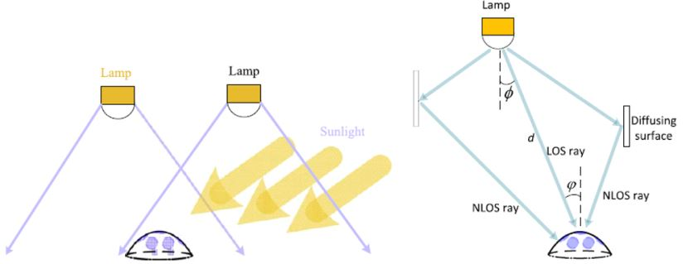
Visible Light Communication Protocol Security
Handover
Existing Handover Mechanisms in VLC-IoT
Horizontal Handover: A handover mechanism commonly executed
in mobile VLC-IoT devices to maintain seamless connectivity and prevent inter-cell
interference.
Vertical Handover : A type of handover mechanism that occurs between
different access layers in VLC-IoT systems,triggered when there is a line-of-sight (LOS)
blockage.
Proposed Handover Approach
RSI-VH: is based on the received signal intensity of the APs at VLC-IoT devices. A handover is triggered when a neighbouring AP has a higher RSI value than the current AP.
Non-LOS-based VH: reduces frequent handovers in VLC-IoT systems. When a VLC-IoT device detects a LOS blockage, it waits for a set time (dwell period) before handover to a neighbouring AP with better channel resources

Slide 6
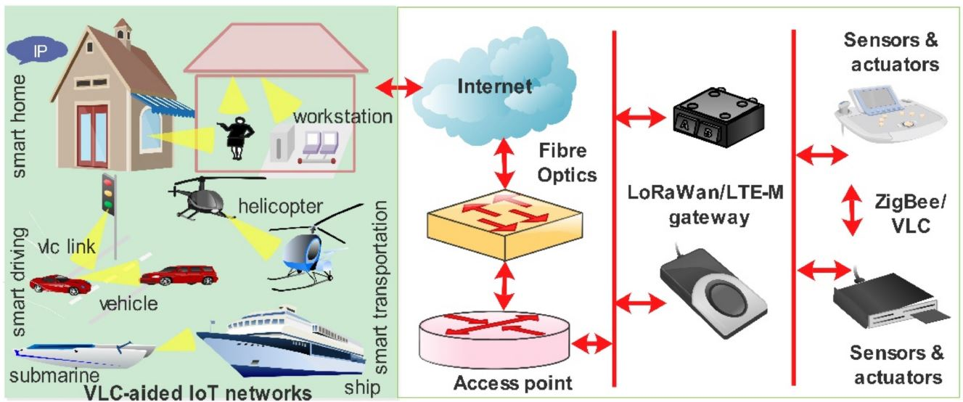
Visible Light Communication Protocol Security
Friendly Jamming/Zero-Forcing
VLC Architecture
involves a central network utilizing VLC technology, connected to a network of sensors, actuators, and Access Points (APs) that communicate with VLC-IoT devices through various communication technologies.

Slide 7
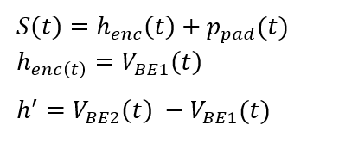
Visible Light Communication Protocol Security
Physical Layer Security
PLS Embedded Encryption: Inherent security, Cryptography for physical and data link layer
cipher cleartext data
key management, key generation, distribution and verification using AES parallel-to-serial rule
private key & Public Key
Chaos-based Physical layer security model
encrypting the packer frame
random bits of data to the payload
Sensitive to internal parameters
signal-generating chaos oscillators and Parameters
computational delay & two synchronized oscillators
Active-Passive Decomposition
physical layer header & MAC frame
Frame Check Sequence and Header Check Sequence

Slide 8
Visible Light Communication Protocol Security
Friendly Jamming/Zero-Forcing
adds an additional transmitter (jammer) different from the main VLS transmitte
eavesdropper's CSI
DRL-Based IRS-Assisted
mirror array sheets
Intelligent Reflecting Surfaces (IRS)
high dimensionality
maximize SNR
deep reinforcement learning model
eavesdropper in proximity
Data Link Layer Security
MAC sublayer
Cryptography computational resources and power consumption
symmetric cryptography
higher layer process
AES in CBC-MAC mode/ Zigbee
MAC dead fields
key management and generation

Slide 9
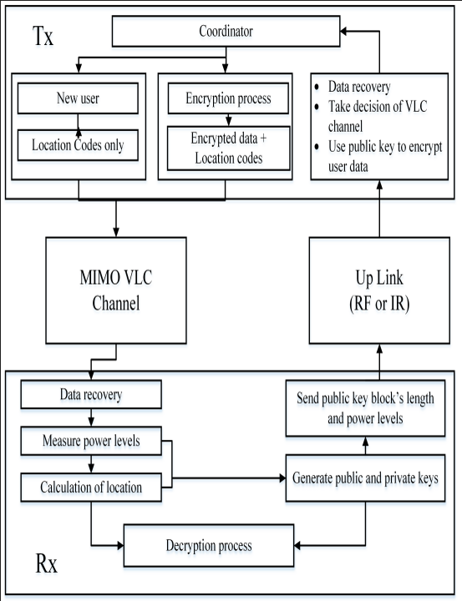
Visible Light Communication Protocol Security
Elliptic Curve Cryptography
mathematical nature of elliptic curves ,
encryption and digital signatures RSA, ECC
IoT environments and VLC
dedicated arithmetic module
shorter key lengths and lower complexity
Chaffing and Winnowing
Message Authentication Codes
encryption and decryption
identification number to block of message
Chaffs, fake MAC and winnowing
VLC Attacks & Vulnerabilities
secure VLC communications
setup and private data
Denial-of-Service, friendly jamming
VLC beam

Slide 10
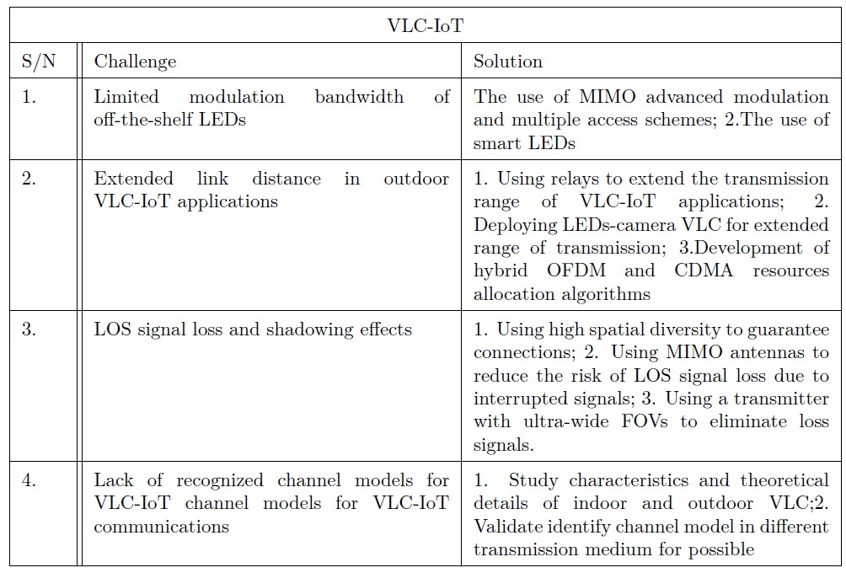
Visible Light Communication Protocol Security
Challenges, Solutions & Opportunities in VLC-IoT

Slide 11
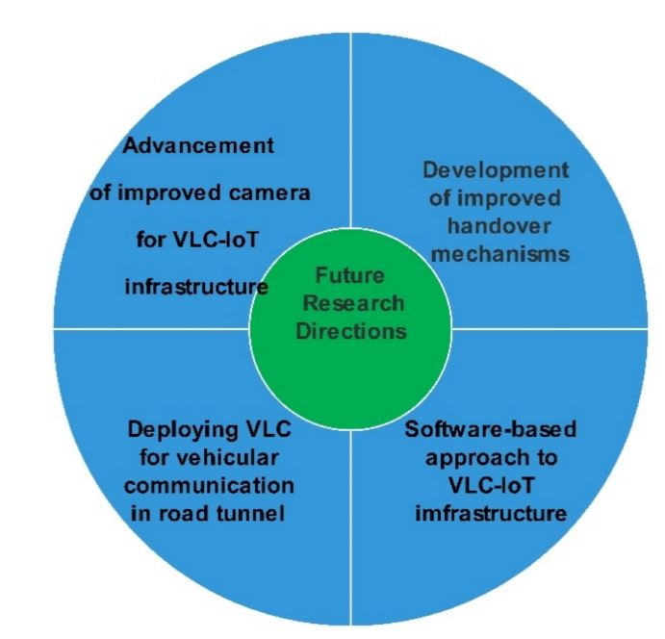
Visible Light Communication Protocol Security
Future opportunities for exploration in VLC-IoT
Research on Improved Handover Techniques
Advanced Receiver Camera Development.
Optical communication image sensor, communication bit rate.
Deploying VLC for vehicular communications in road tunnels.
Potential substitute for traditional RF.
Vehicular communications,
Confined locations,
Highest data rates,
Length of the link,
Impact on the VLC channel in tunnel
Software-based approach to VLC-IoT infrastructure.
Hardware remote control,
Local control decisions,
Infrastructure-less VLC system
Notes:
•Research on Improved Handover Techniques
communication connectivity and quality of service in the face of LOS blockages
•Advanced Receiver Camera Development.
optical communication image sensor, communication bit rate.
•Deploying VLC for vehicular communications in road tunnels
•potential substitute for traditional RF . vehicular communications, confined locations, highest data rates, length of the link, impact on the VLC channel in tunnel
•Software-based approach to VLC-IoT infrastructure. hardware remote control, local control decisions, infrastructure-less VLC system

Slide 12
Visible Light Communication Protocol Security
Challenges and Opportunities for VLC
The limited range and area coverage of VLC.
Reliance on LOS,
Interference from other sources,
Significant research and development efforts,
Advanced modulation and coding techniques,
Optical component development,
Hybrid communication systems.
Development of high-data-rate systems
competitive alternative, integrating with other, Wi-Fi, cellular, Bluetooth

Slide 13
Visible Light Communication Protocol Security
Conclusion
Our research delved into the complexities of this fascinating technology in this academic analysis of visible light communications, looking at its underlying ideas, various uses, cutting-edge multiple access methods, enduring difficulties, and the crucial role of physical layer security. As indicated by its integration with cutting-edge technologies, the expansion of high-speed data systems, and the booming acceptance in both the industrial and consumer spheres, VLC is ready to spark a revolution in wireless communication with its enormous potential.
To overcome the challenges that VLC faces and reach its full potential, research and development must continue without ceasing. The scientific community is being challenged to harness VLC's power and release its transformative potential in response to this call to action. VLC's future is promising and realistic.

